Slide 1
Introduction to 8086 Microprocessor (part 1)
Microprocessors and microcomputer-based system design
Mohamad Rafiquzzaman
>Chapter 3 section 3.1, 3.2, 3.3
Assembly language programming Ytha Yu
> Chapter 3 section 3.2
Md. Shafqat Talukder Rakin
Lecturer, Department of CSE,
United International University
Email id : shafqat@cse.uiu.ac.bd
Courtesy: Nasif M. Sir

Slide 2
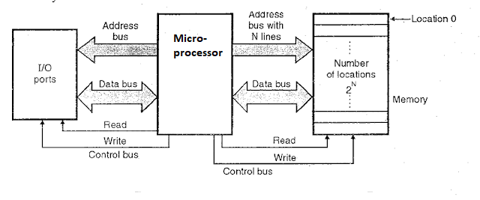
Micro-processor interfacing with memory device (ROM/RAM) and I/0 device (keyboard/printer)

Slide 3
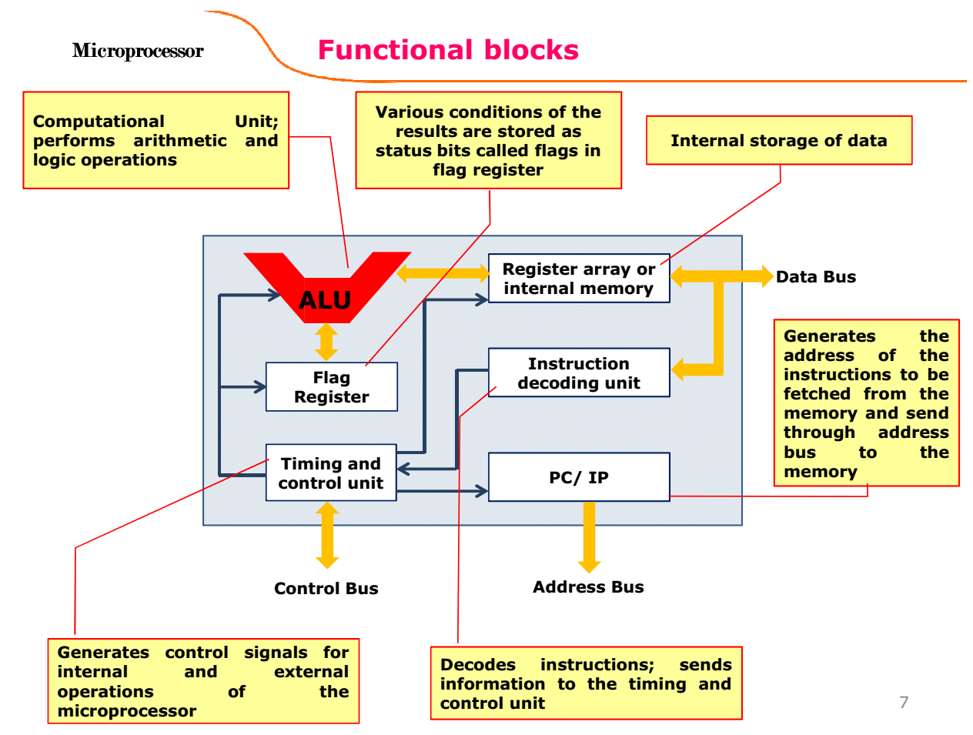
inside micro-processor

Slide 4
Microprocessors Family
8085 : 8-bit micro-processor
8086 Family:
8086: First 16-bit processor
80186: 16-bit 8086 with peripheral devices
80286: Advanced version of 8086 used for multitasking.
80386: 32-bit processor architecture
80486: 32-bit processor architecture with floating point
processor(80387) integrated into the chip.
8088 Family:
8088: Same as 8086 but 8-bit databus.
80188: 8088 with peripheral devices.

Slide 5
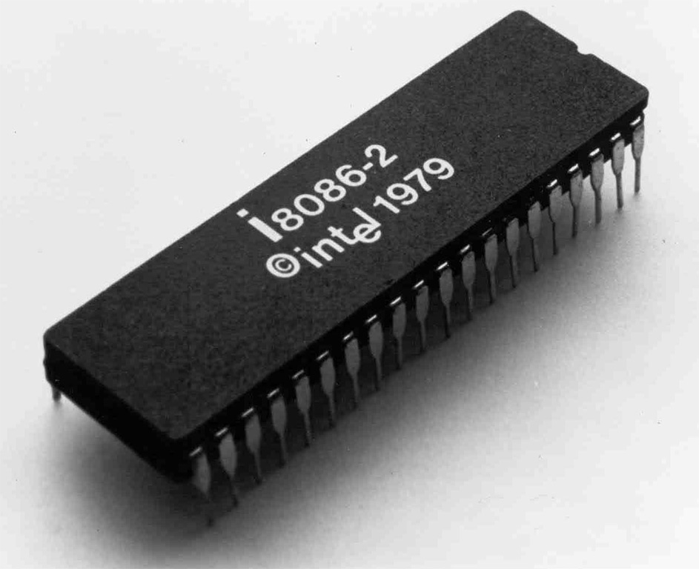

Slide 6
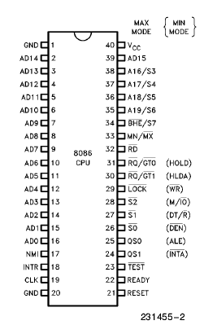
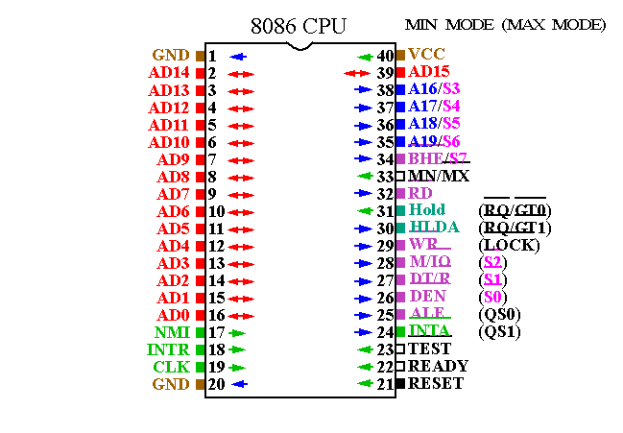
8086 Pin Diagram

Slide 7
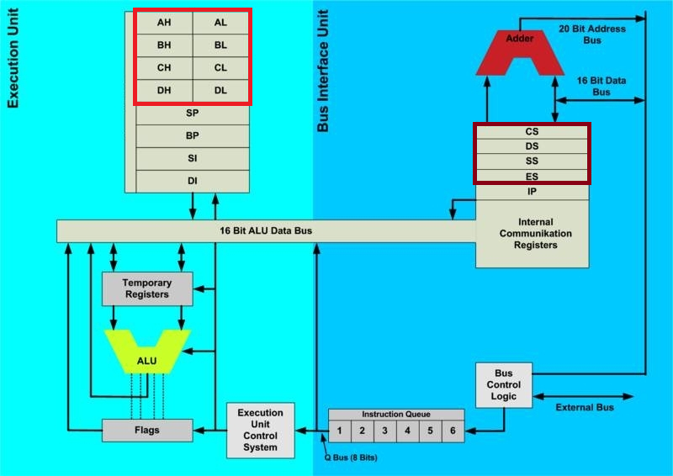
8086 Internal Architecture

Slide 8
8086 Features
Operating Clock rates are 5, 8, 10 MHz.
16-bit Arithmetic Logic Unit
16-bit data bus
20-bit address bus

Slide 9
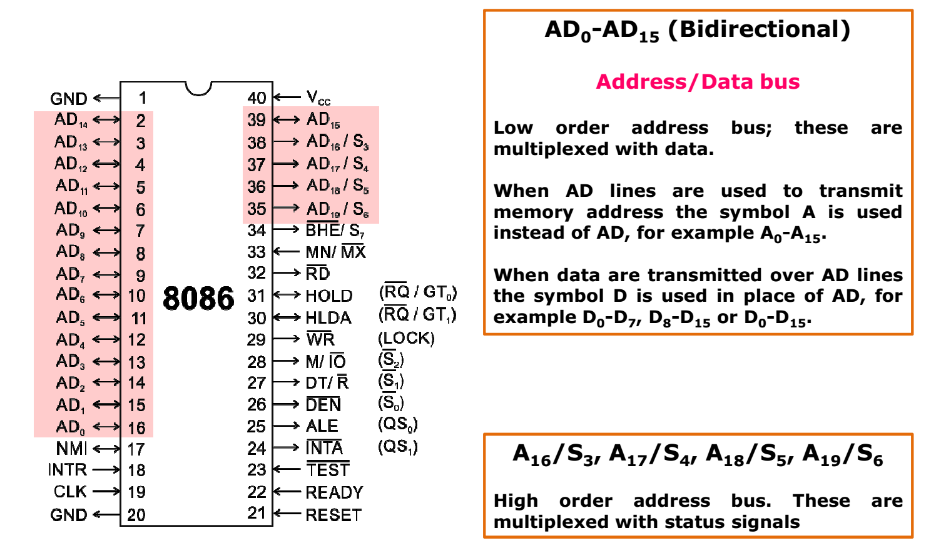

Slide 10
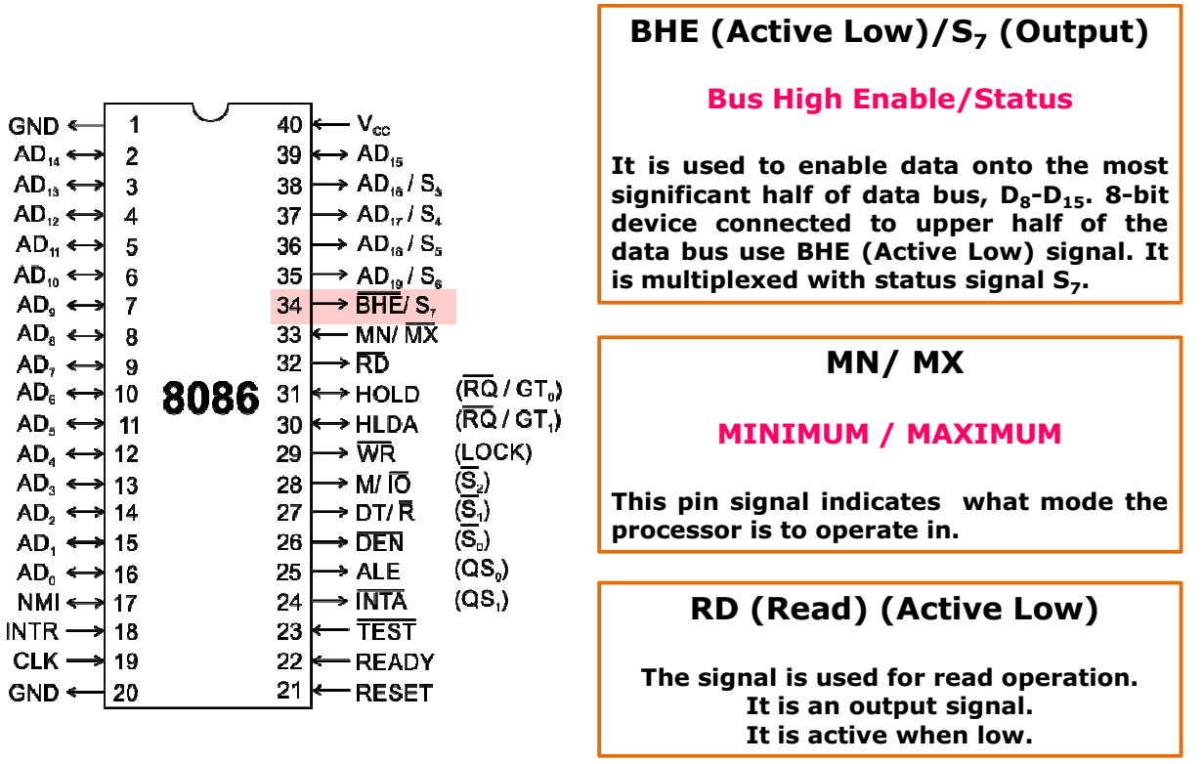

Slide 11
Intel 8086 known as 16 bit microprocessor
The bit size of a processor is normally defined by it ALU width, which equates to its main working register width. (e.g.: AX, BX, CX, DX).
8086 processor is capable to process the 16 bit data together. It means a data with 16 bit can be processed and can be send to processor in single oscillation.

Slide 12
Memory capacity/size
Address 20 bit
Data 8 bit
00000000000000000000
1st data
2nd data
3rd data
4th data
5th data
Data bus 16 bit
00000000000000000001
00000000000000000010
00000000000000000011
00000000000000000100
Memory

Slide 13
8086 capacity/size
Memory addressing capacity depends upon number of address lines in CPU
Set of all possible addresses that can be generated by CPU is called address space. CPU can directly address all the addresses of it’s address space.
Eg: 8086 intel microprocessor has 20 address lines and can address 1MB of memory directly using 20 bit address bus.
Thus 1MB is the address space of INTEL 8086 microprocessor. This is also it’s memory size or capacity.

Slide 14
8086 capacity/size
220 = 1048576 no. of memory locations
Each memory location has 8 bit data size
Total memory size: 1048576 * 8 bit=8388608 bit = 1048576 byte = 1024 Kbyte = 1Mbyte

Slide 15
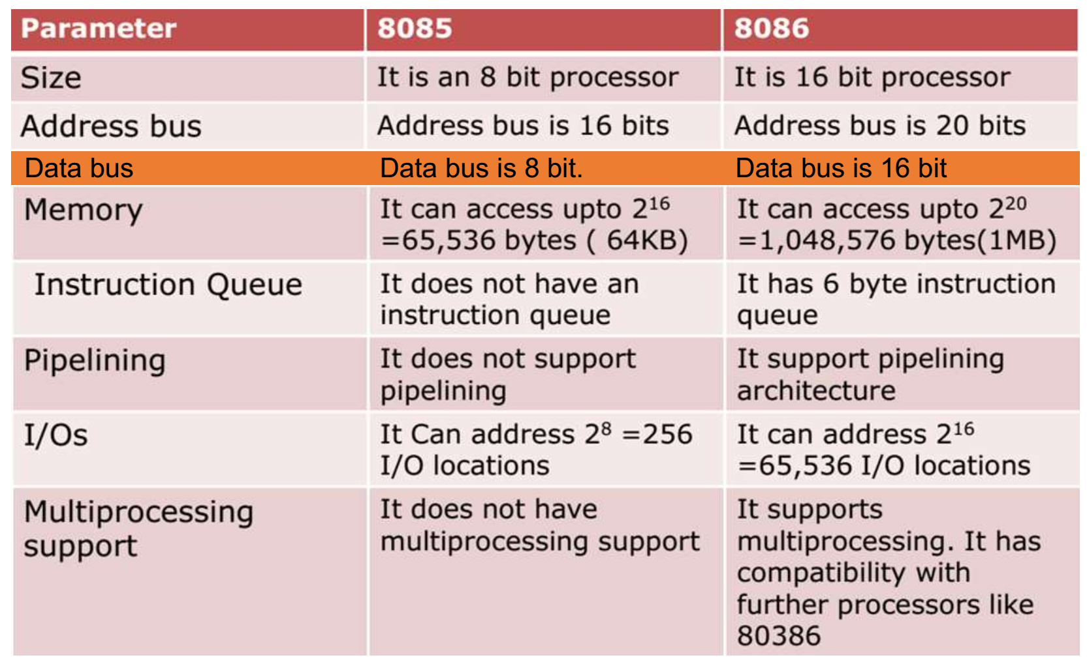
Difference between micro-processor 8085 and 8086

Slide 16
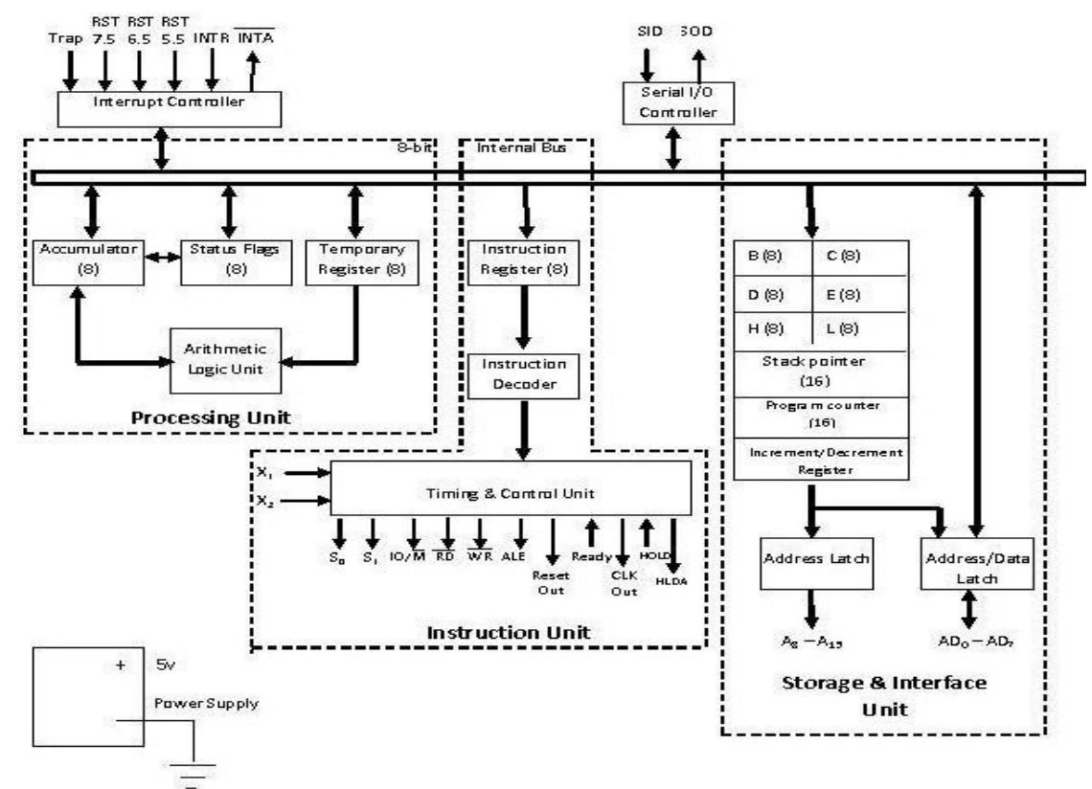
Intel 8085 internal architecture

